Slide 1

CLOUD COMPUTING INTERNSHIP REPORT
A one-month hands-on internship with Alfido Tech, deploying real workloads
on Amazon Web Services
Palash Malviya
B.Tech CSE | IILM University, Greater Noida | Batch 2026-27
Candidate ID: BS/REG/126233
Internship Duration: 10 Aug 2026 – 10 Sep 2026

Slide 2
OVERVIEW
What This Report Covers
01
Introduction & Organization
Alfido Tech, the internship model, and the problem this work addresses
4
02
Objectives & Scope
What the internship set out to achieve, and its boundaries
Cloud tasks completed
03
Tools & Architecture
100%
The AWS services and the request flow behind each deployment
Four Deployment Tasks
Publicly verifiable
04
S3, EC2, Lambda + API Gateway, and Docker — step by step
1
05
Outcomes & Takeaways
Results achieved and skills gained
Month, hands-on
2

Slide 3
SECTION 4.1
Introduction
This report presents the work carried out during the Cloud Computing Internship undertaken at Alfido Tech. The internship was designed to provide hands-on, practical exposure to core AWS services — moving beyond theory into real deployment scenarios.
Static Hosting
Compute
Website served directly from storage
Provisioning & web server configuration
Four independent tasks were completed, each targeting a distinct area of cloud infrastructure. Every task ran end-to-end — from provisioning to a publicly verifiable result — using the AWS Free Tier console.
Serverless
Containers
Function execution with public API
Dockerized app on a cloud VM
Amazon S3
Amazon EC2
AWS Lambda
API Gateway
Docker
3

Slide 4
SECTION 4.2
Organization Profile
Alfido Tech
SUPERVISOR / MENTOR
Akash Dubey
A Hyderabad, Telangana (India) based technology training organization running structured, task-based internship programs for engineering students, with a focus on emerging domains such as Cloud Computing.
INTERNSHIP DURATION
10 Aug 2026 – 10 Sep 2026
Registered under MSME and ISO 9001:2015, with internship programs recognized in line with AICTE guidelines. The model is built around real-world, hands-on tasks — supported by curated resources, mentor guidance, and a coordination team.
CANDIDATE ID
BS/REG/126233
On completion of all tasks, interns receive an official Internship Completion Certificate
High performers may become eligible for a Letter of Recommendation (LOR)
AWS REGION USED
eu-north-1 (Stockholm)
4

Slide 5
SECTION 4.3
The Problem Statement
Traditional on-premises infrastructure requires significant upfront investment, manual server management, and lacks the elasticity needed to handle variable workloads.
Organizations increasingly need to deploy websites, applications, backend logic, and containerized services in a way that is scalable, cost-effective, and quickly provisioned.
This internship set out to gain practical competence deploying and managing such services on AWS — covering static content hosting, compute, serverless execution, and containerization, with every deployment configured securely and publicly verifiable.
5

Slide 6
SECTION 4.4
Project Objectives
1
Deploy a static website using Amazon S3 with public access configured through bucket policies
2
Provision a virtual machine on Amazon EC2, configure network security, and install/run Apache2
3
Design and deploy a serverless function using AWS Lambda, exposed via Amazon API Gateway
4
Deploy a containerized application (Nginx) using Docker on a cloud-hosted Ubuntu VM
5
Document each deployment with configuration details, commands used, and verification evidence
6

Slide 7
SECTION 4.5
Scope of the Project
IN SCOPE
OUT OF SCOPE
Storage-based static hosting (Amazon S3)
Compute provisioning (Amazon EC2)
Serverless execution + API exposure (Lambda + API Gateway)
Containerized deployment (Docker on EC2)
All work performed on the AWS Free Tier, eu-north-1 (Stockholm) region
Custom domain mapping
HTTPS / TLS certificates
Auto-scaling and load balancing
CI/CD pipelines
Infrastructure-as-code automation
These represent natural extensions for future work.
7

Slide 8
SECTION 4.6
Technologies & Tools Used
CLOUD PLATFORM
STORAGE / HOSTING
COMPUTE
Amazon Web Services (AWS)
Amazon S3 (Static Website Hosting)
Amazon EC2, Ubuntu Server
WEB SERVER
SERVERLESS COMPUTING
API MANAGEMENT
Apache2
AWS Lambda (Python 3.12)
Amazon API Gateway (REST API)
CONTAINERIZATION
LANGUAGES
OPERATING SYSTEM
Docker, Nginx
HTML, CSS, JavaScript, Python
Ubuntu Server (24.04 LTS)
8

Slide 9
SECTION 4.7
System Architecture
Request flow for each of the four deployments
Task 1 — Static Website
User
→
Internet
→
Amazon S3
(Static Website)
Task 2 — Virtual Machine + Web Server
User
→
Internet
→
AWS EC2
(Ubuntu)
→
Apache2 →
Webpage
Task 3 — Serverless Function
Client
→
API
Gateway
→
AWS Lambda
(Python)
→
JSON
Response
Task 4 — Docker Container on Cloud VM
User
→
Internet
→
AWS EC2
(Ubuntu)
→
Docker →
Nginx →
Webpage
9

Slide 10
SECTION 4.8
Methodology
The same five-step approach was followed for every task
1
2
3
4
5
Provision the required AWS resource
Apply security & network configuration
Install / deploy the target software
Verify functionality via AWS console
Validate public access through a browser
→
→
→
→
10

Slide 11
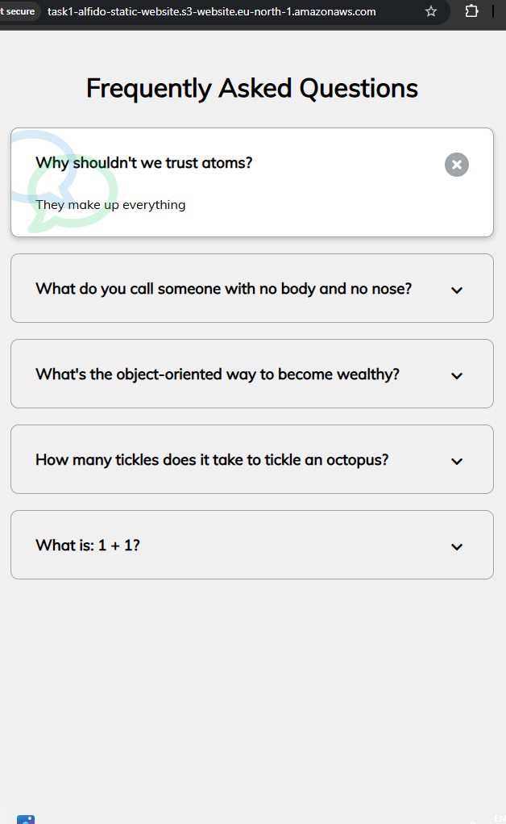
TASK 1 · SECTION 4.8.1
Static Website on Amazon S3
Deploy a static website using Amazon S3, served entirely from storage — no traditional web server required.
BUCKET:
task1-alfido-static-website
REGION:
eu-north-1 (Stockholm)
KEY STEPS
Created S3 bucket & enabled static website hosting
Disabled Block Public Access; set index.html as index document
Uploaded index.html, CSS and JavaScript files
Applied a bucket policy allowing public s3:GetObject
Verified the site via the S3 website endpoint
✓ Website successfully deployed and publicly accessible
Live static website accessed via the S3 website endpoint
11

Slide 12
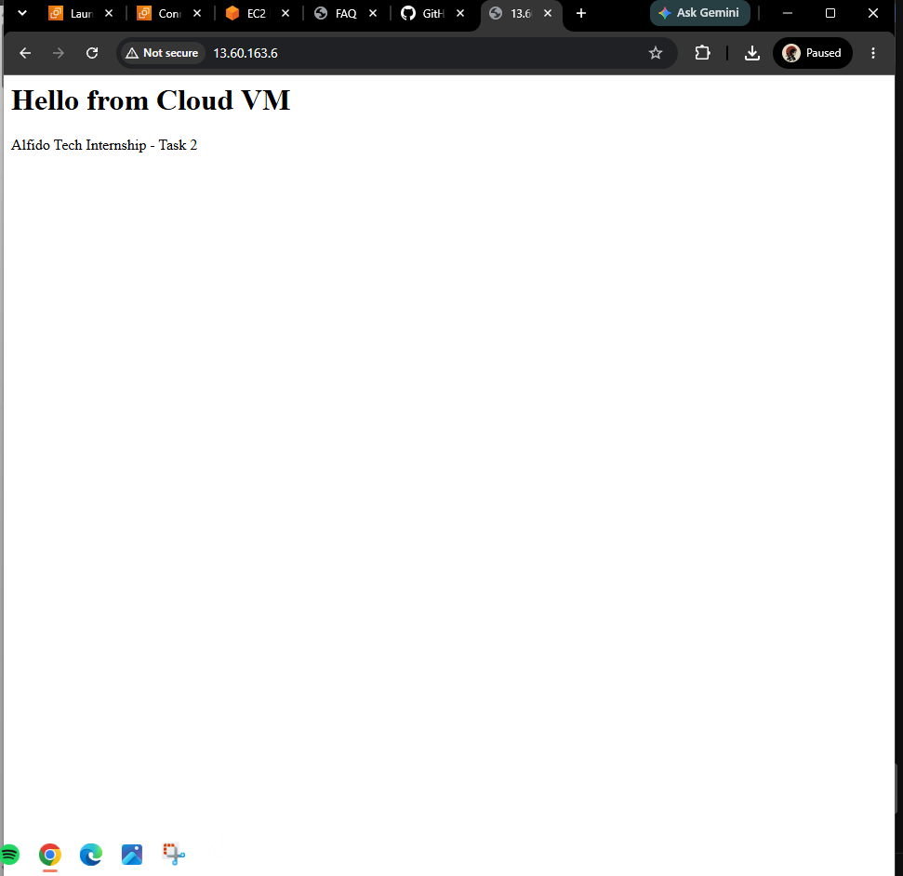
TASK 2 · SECTION 4.8.2
Virtual Machine & Web Server
Provision an Ubuntu EC2 instance, open port 80, and host a custom page with Apache2.
INSTANCE:
task2-alfido-cloud-vm
PUBLIC IPV4:
13.60.163.6
WEB SERVER:
Apache2, port 80
KEY STEPS
Launched an Ubuntu Server EC2 instance
Configured security group for HTTP (80) & SSH (22)
Connected via EC2 Instance Connect
Installed & enabled Apache2 (apt install apache2)
Published a custom index.html and verified over HTTP
✓ Apache served the custom page over the public IP
Custom "Hello from Cloud VM" page served by Apache2
12

Slide 13
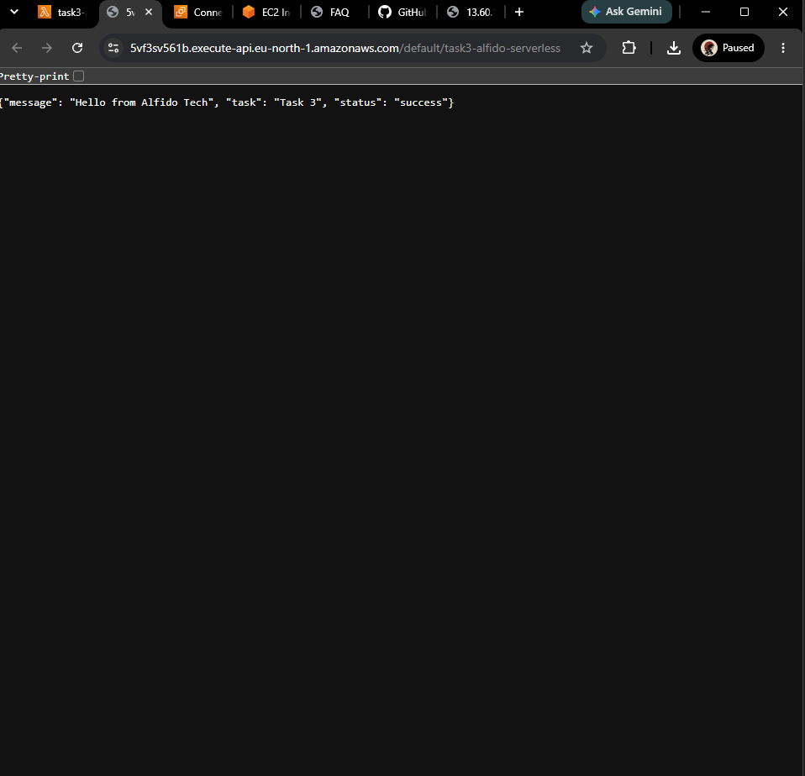
TASK 3 · SECTION 4.8.3
Serverless Function (Lambda + API Gateway)
Build a Python Lambda function returning JSON, exposed publicly through API Gateway.
FUNCTION:
task3-alfido-serverless
RUNTIME:
Python 3.12
KEY STEPS
Created a Lambda function with the Python 3.12 runtime
Wrote a handler returning a structured JSON response
Tested execution directly in the Lambda console
Attached an API Gateway (REST API) trigger, open access
Deployed and confirmed the public endpoint returns JSON
✓ Public API endpoint returns the expected JSON output
Public API Gateway endpoint returning JSON from Lambda
13

Slide 14
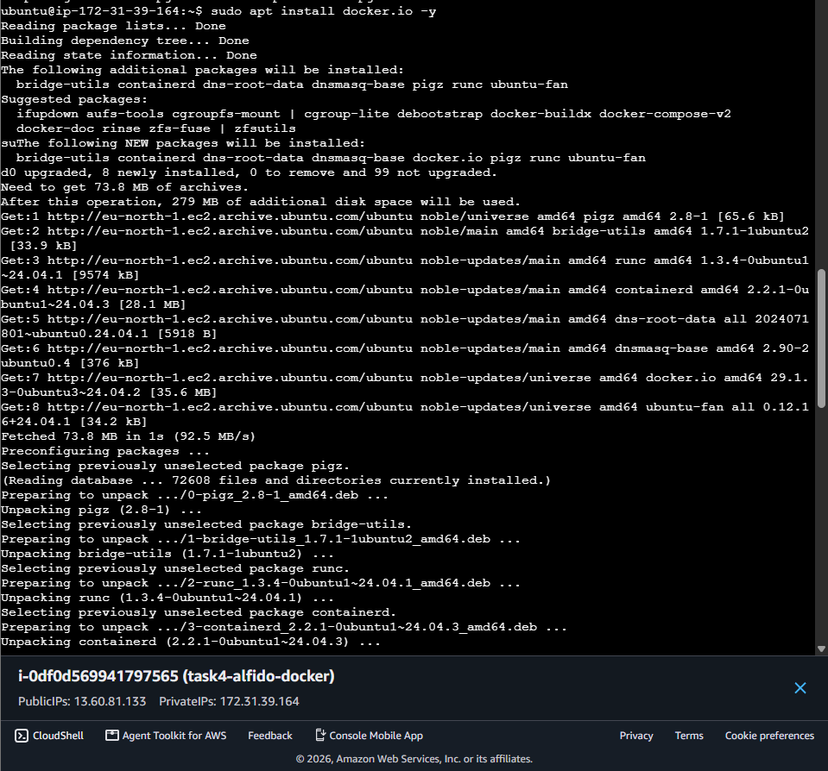
TASK 4 · SECTION 4.8.4
Docker Container on Cloud VM
Run a containerized Nginx app on a separate EC2 VM, reachable over the public internet.
VM:
task4-alfido-docker
PUBLIC IP:
13.60.81.133
CONTAINER:
alfido-nginx (Nginx)
KEY STEPS
Launched a second Ubuntu EC2 VM; opened ports 22 & 80
Installed Docker (apt install docker.io) and enabled the service
Pulled and ran Nginx: docker run -d -p 80:80 nginx
Verified the running container with docker ps
Confirmed the "Welcome to nginx!" page over the public IP
✓ Nginx container publicly reachable on the VM's IP
Installing Docker on the task4-alfido-docker EC2 instance
14

Slide 15
SECTION 4.9
Expected Outcomes
✓
A publicly accessible static website hosted entirely on Amazon S3
✓
A cloud-hosted Ubuntu VM running Apache2 over HTTP on port 80
✓
A working AWS Lambda function invoked via a public API Gateway endpoint, returning structured JSON
✓
A Docker (Nginx) container running on a cloud VM, publicly accessible via its IP
✓
Practical, hands-on familiarity with S3, EC2, Lambda, API Gateway, Linux administration and Docker
15

Slide 16
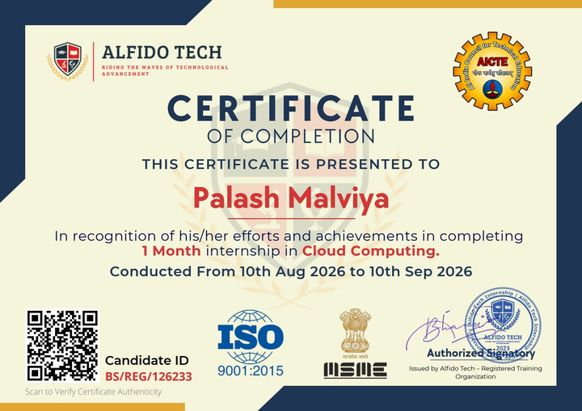
SECTION 4.10
Certificate of Completion
On successful completion of all four tasks, Alfido Tech issued an official Internship Completion Certificate.
Internship Completion Certificate issued by Alfido Tech — Candidate ID: BS/REG/126233
16

Slide 17
CONCLUSION
Key Learnings
End-to-end cloud deployment
Security-conscious defaults
From provisioning through configuration to public verification, across four distinct AWS services.
Every deployment configured with deliberate access control — bucket policies, security groups, and scoped API access.
Breadth across the stack
Documentation discipline
Storage, compute, serverless, and containers — a rounded view of how modern cloud workloads run.
Each task backed by commands used, configuration details, and screenshot evidence.
17

Slide 18
SECTION 5
Bibliography / References
[1]
Amazon Web Services, "Amazon S3 – Static website hosting," AWS Documentation.
[2]
Amazon Web Services, "Amazon EC2 User Guide," AWS Documentation.
[3]
Amazon Web Services, "AWS Lambda Developer Guide," AWS Documentation.
[4]
Amazon Web Services, "Amazon API Gateway Developer Guide," AWS Documentation.
[5]
Docker Inc., "Docker Documentation."
[6]
The Apache Software Foundation, "Apache HTTP Server Documentation."
[7]
Canonical Ltd., "Ubuntu Server Documentation."
[8]
Alfido Tech, Cloud Computing Internship – Task 1 to Task 4 completion documents (internal internship material), 2026.
18

Slide 19
Thank You
Cloud Computing Internship · Alfido Tech
Palash Malviya | B.Tech CSE, IILM University | Candidate ID: BS/REG/126233

